Slide 1
ANT Trucks data analysis
GROUP 3
Gande, Avinash
Ganduri, Catherine Christina
Goel, Ashish
Gupta, Ruchika
Jasti, Gnaneshwar
Jawahar Vasagam, Premi
Karur, Vishal

Slide 2
BUSINESS QUESTIONS
Identifying the Optimal Truck Model
Historical MPG values analysis
Risk factor analysis for each truck model
Choosing the best truck model for expansion
Benefits of partnering with the truck company for future purchases and maintenance operations
Identifying High-Risk Drivers
Data analysis approach for driver risk identification
Top 5 high-risk drivers and causal factors
Implications for compliance with traffic rules and regulations
Strategies for hiring and training better employees for safer driving

Slide 3
BUSINESS PLAN
Driver Risk Prediction
Factors affecting driver risk
Predictive model development
Data analysis approach
Risk factors and characteristics
Accident Reduction for Commercial Trucks
Driver data analysis for risk identification
Strategies for reducing accidents
Impact on road safety
Risky Driver Identification

Slide 4
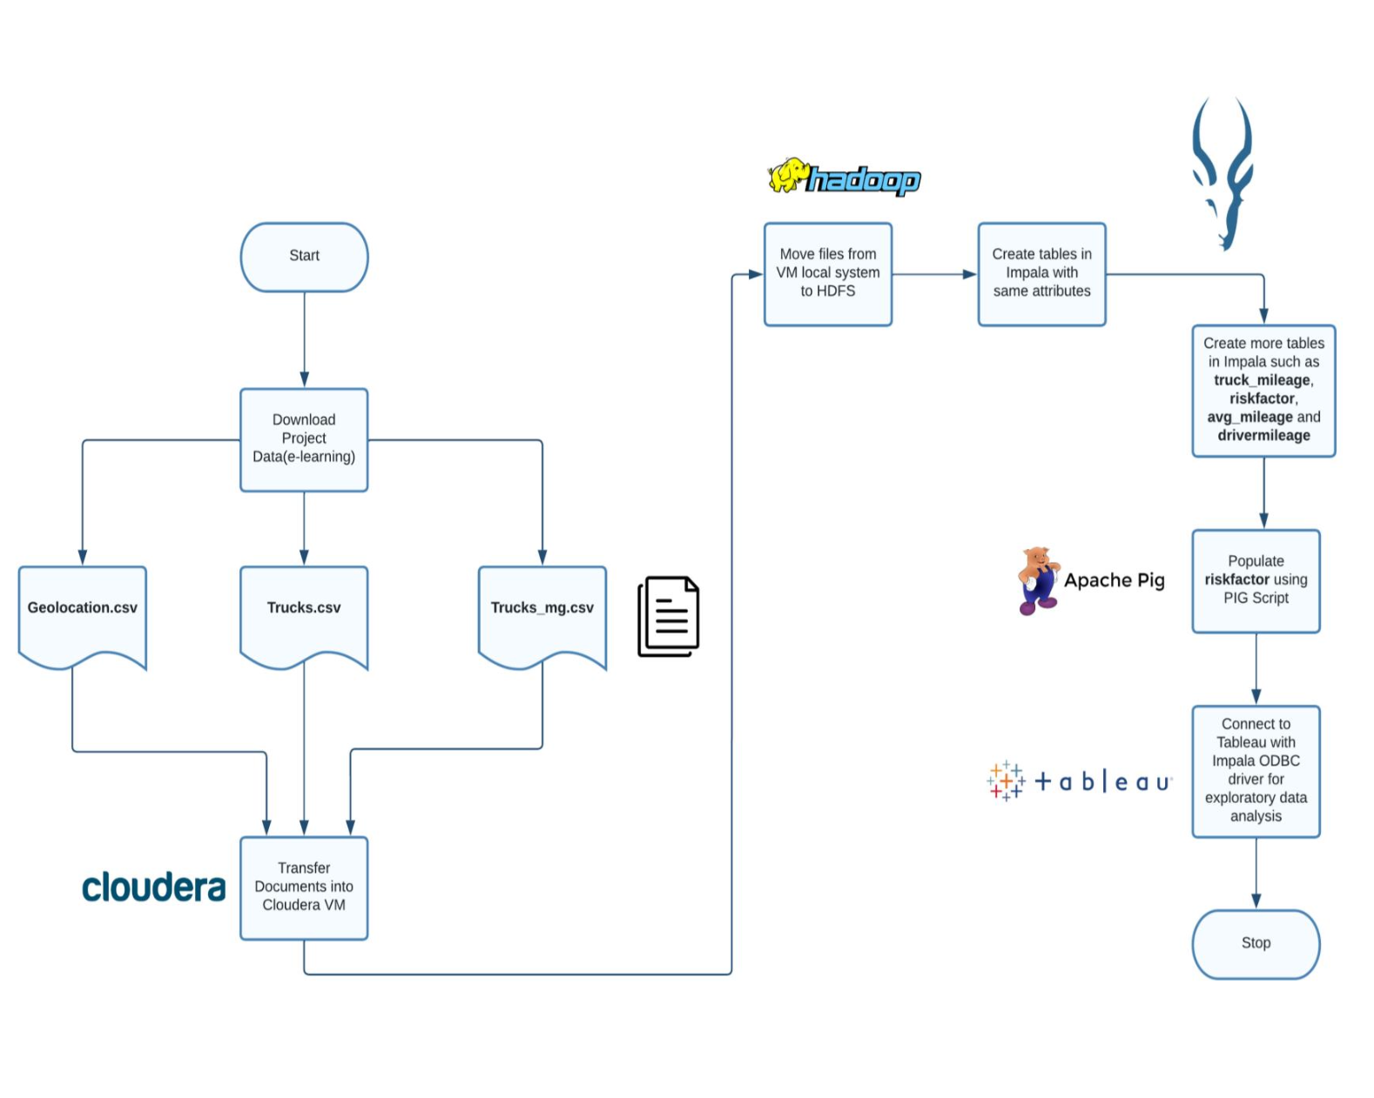
DATA FLOW PROCESS

Slide 5
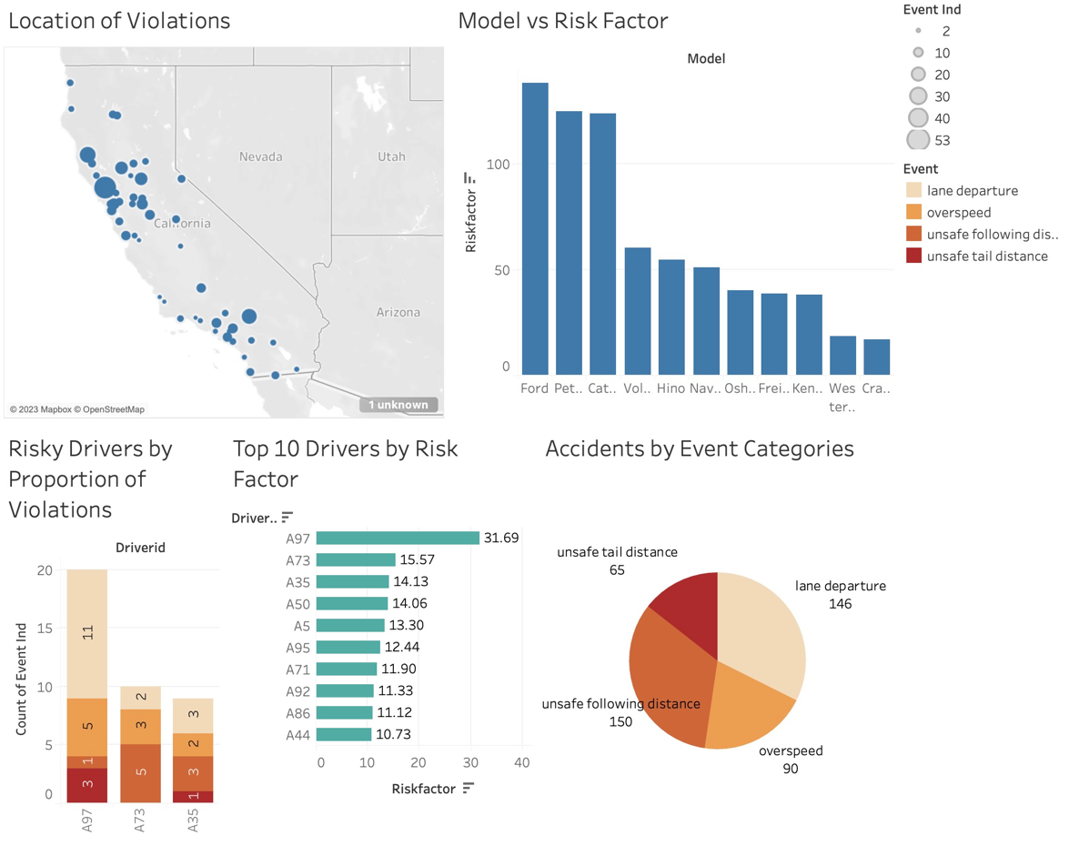
Dashboard

Slide 6
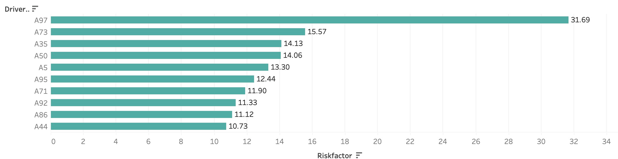
Top 10 Drivers by Risk factor
The above graph observes drivers with highest risk ratings. By analyzing the risk factor computed by the company, it is apparent that Driver "A97" is the most hazardous driver with a risk factor of 31.69.

Slide 7
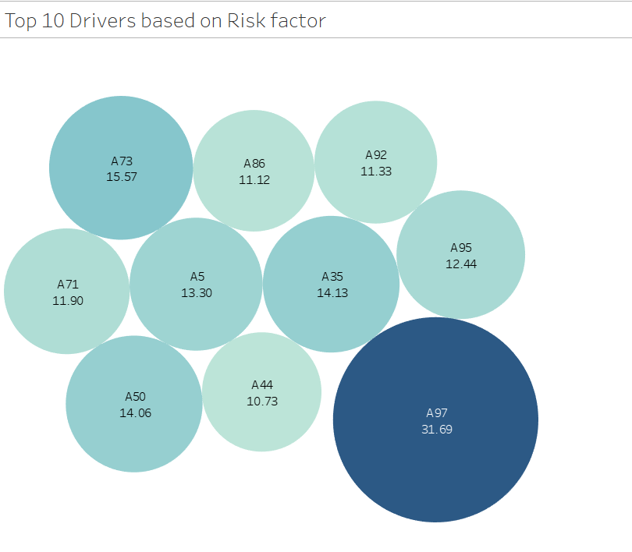
Identifying Drivers With highest risk factor
Driver A97 has the highest risk factor of 31.69. However, there is a large gap between A97 and other drivers in terms of risk factor
Drivers with a high risk factor fall in the range of 10 and 15
Insights
Driver A97 could be a one-off instance which can be dealt with separately.

Slide 8
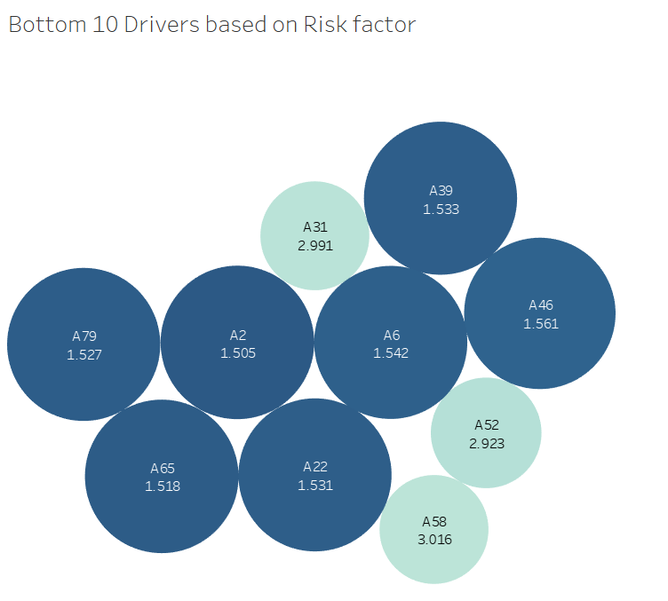
Identifying Drivers With Lowest risk factor
Driver A2 has the least risk factor of 1.505.
Drivers A65, A79 and A22 follow
Drivers with a lower risk factor fall in the range of 1.5 and 3
Insights
Many of the drivers are in the lower range of risk factor which means most of them follow the set guidelines while on road

Slide 9
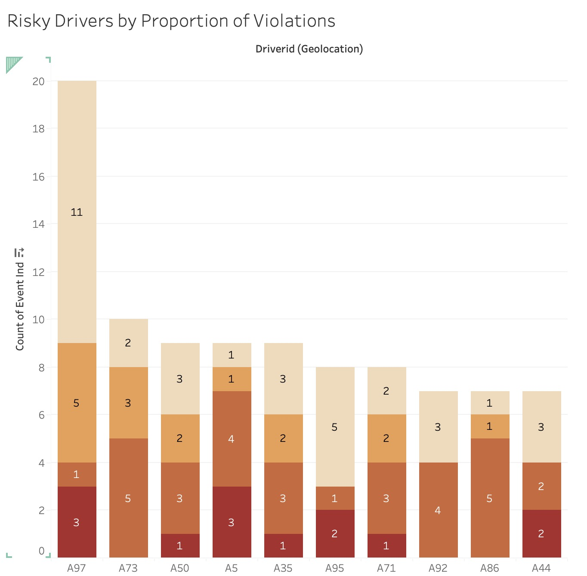
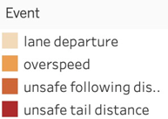
Risky drivers by proportion of violations
The graph shows the proportion of violations by the top three risky drivers.
“Lane Departure” is one of the highest occurring violation with driver “A97” followed by “Overspeed”.
Similarly, “Overspeed” is the main violation associated with driver “A73” whereas, “lane Departure” and “Overspeed” are the concerns related to driver “A35”.
Recommendations
Incentivizing Safe Driving: Offering incentives to drivers who maintain safe follow distances and avoid lane departure, as a way to encourage them to adopt safe driving practices.
Providing training sessions for drivers to improve their driving skills, specifically on maintaining a safe follow distance and avoiding lane departure.

Slide 10
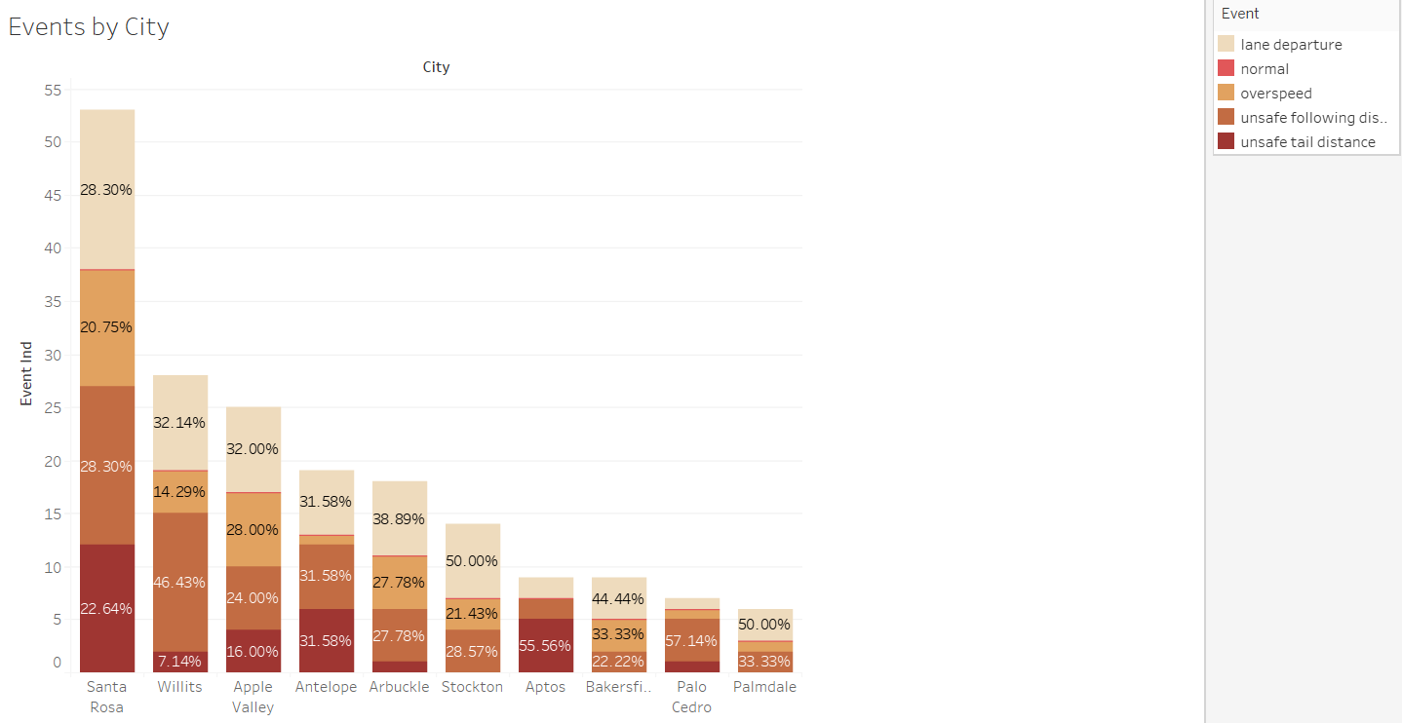
EVENT BREAKDOWN AMONG CITIES With HIGHEST EVENTS
Total number of miles driven by drivers is correlated to the number of incidents
Insight - Out of cities with higher events, drivers are mainly departing their lanes and maintaining unsafe following distance

Slide 11
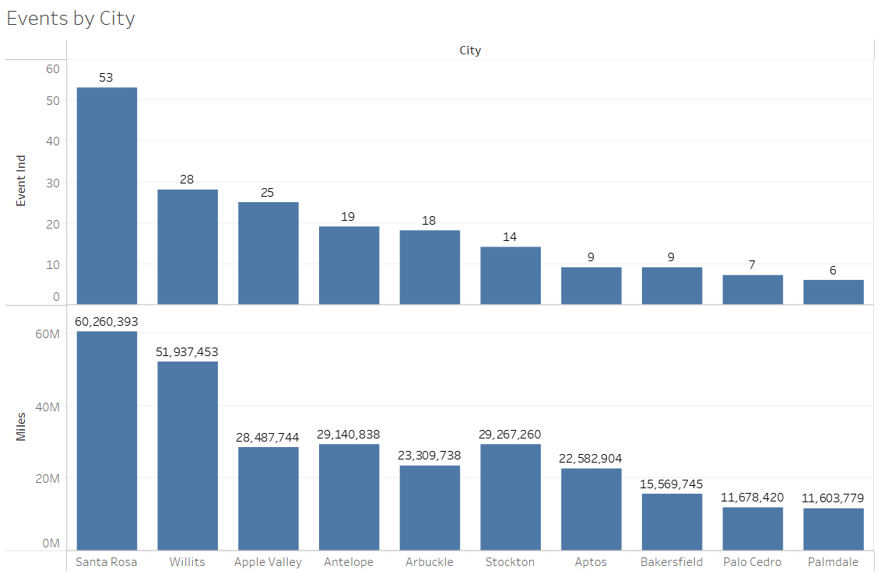
CITIES With HIGHER EVENTS and Miles Driven
Santa Rosa has the highest number of events followed by Willits and Apple Valley
Insights
Total number of miles driven by drivers is correlated to the number of incidents

Slide 12
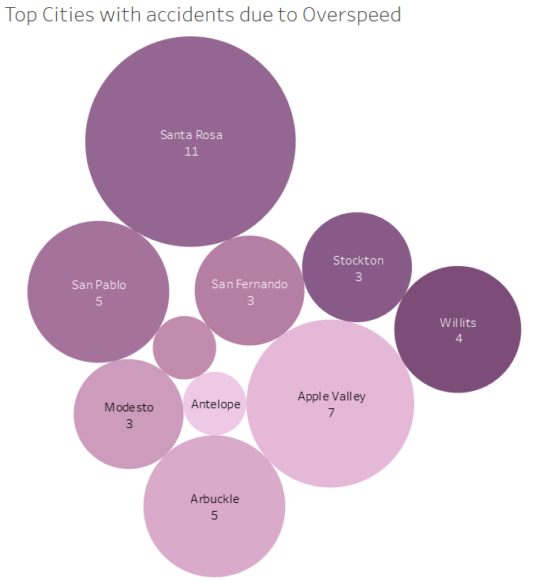
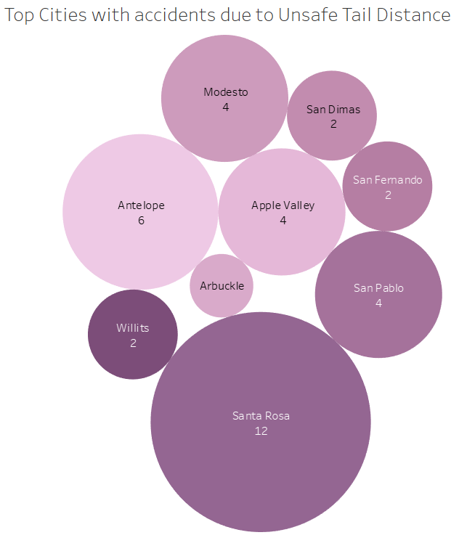
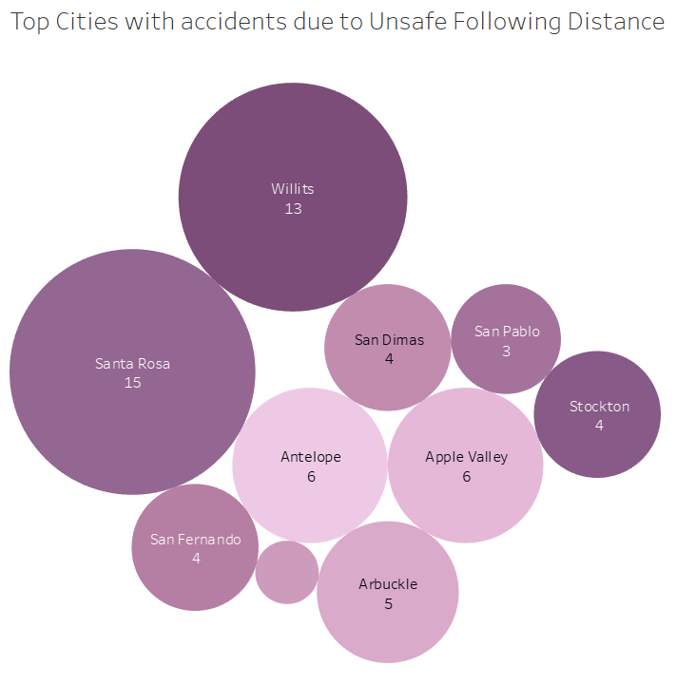
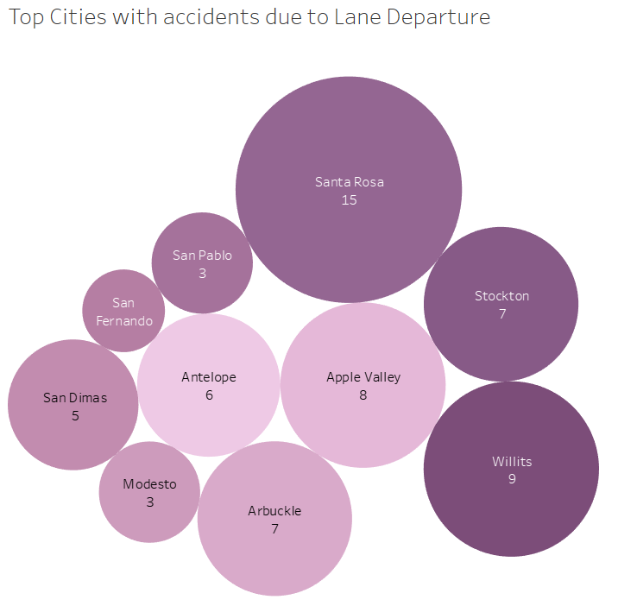
Top Cities with accidents by Event Categories
By observation, Santa Rose in California has the highest number of violations.
Other cities include San Pablo, San Fernando, Willits.
Recommendations
We can conduct a review of the routes to identify areas that are prone to congestion and accidents and avoid them or reroute the drivers when necessary.

Slide 13
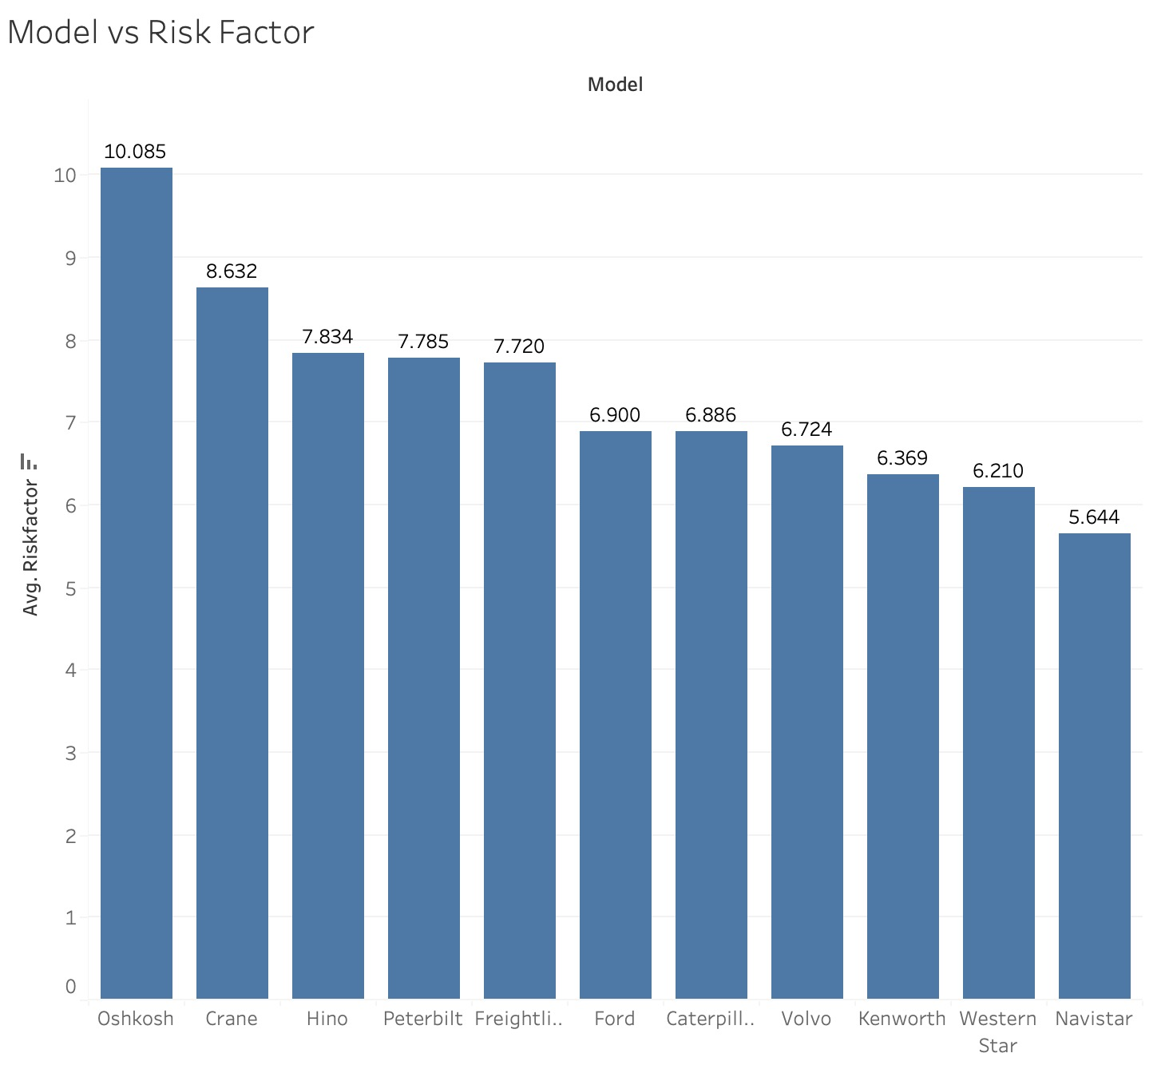
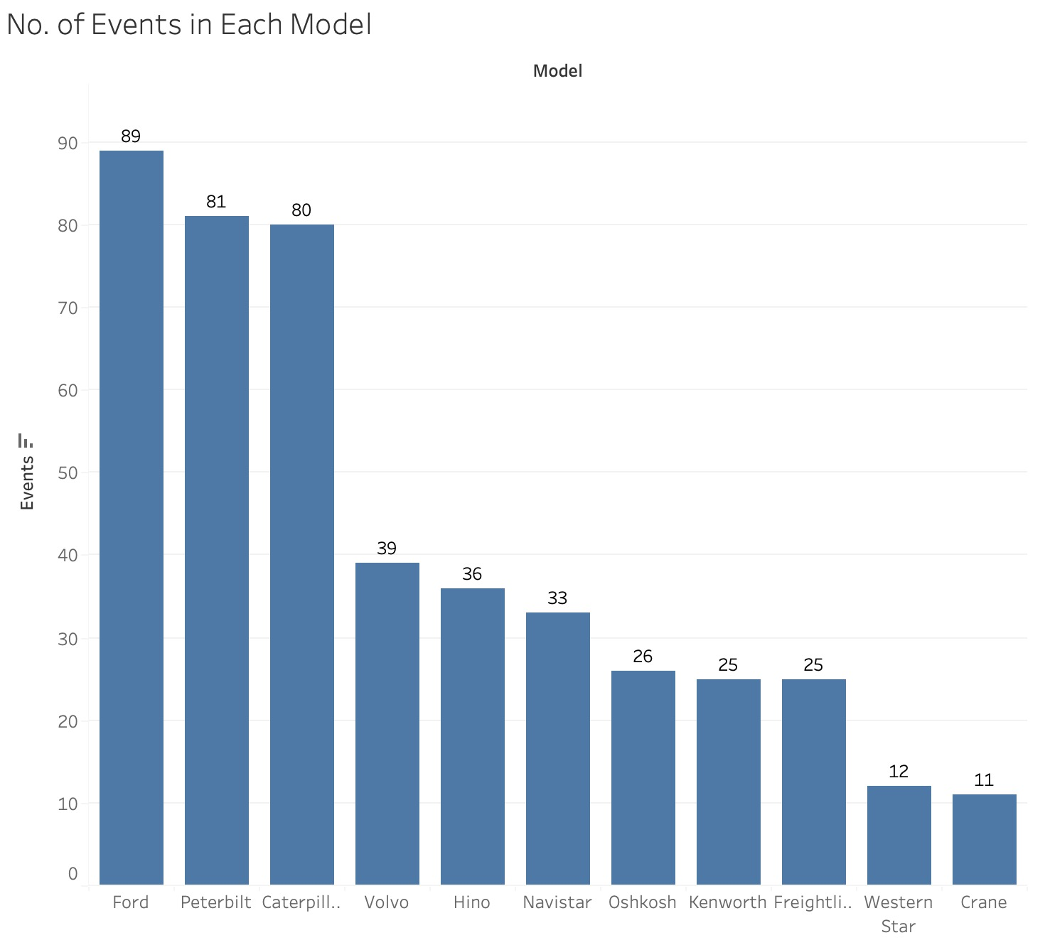
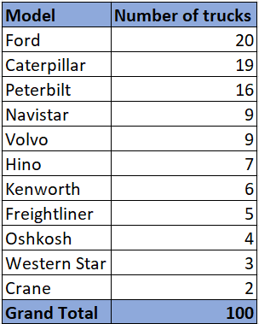
Risk Factor by Model
Although Ford has the maximum number of trucks and maximum number of events, Oshkosh has the highest risk factor.
Nevertheless, it should be noted that the risk factor is predominantly influenced by the driver rather than the model.

Slide 14
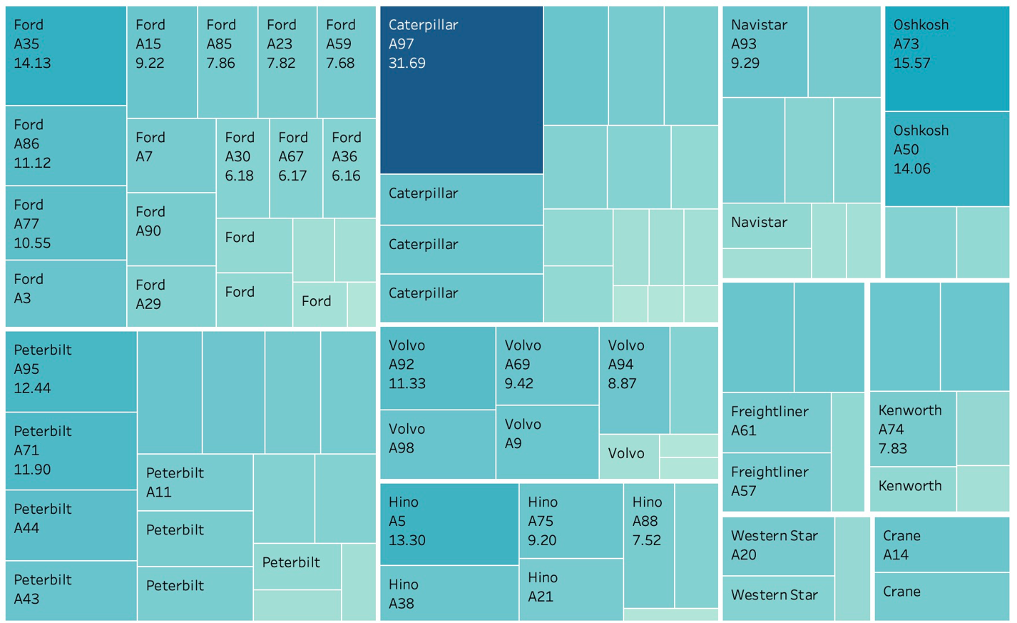
Risk Factor by Model & Driver ID
As we can see in the heat map, A97 driver has the highest risk factor of 31.69. By observation, the highest risk factor is associated with Caterpillar model.
Other drivers with significantly high risk rating are A73 and A35. The risk ratings are 15.57 and 14.13 respectively.
Recommendation
For drivers with high risk ratings such as A73 and A35, it may be beneficial to provide additional training or coaching to help improve their driving behaviors and reduce the risk of incidents. This could include defensive driving techniques, avoiding distractions while driving, and adhering to safe driving practices.

Slide 15
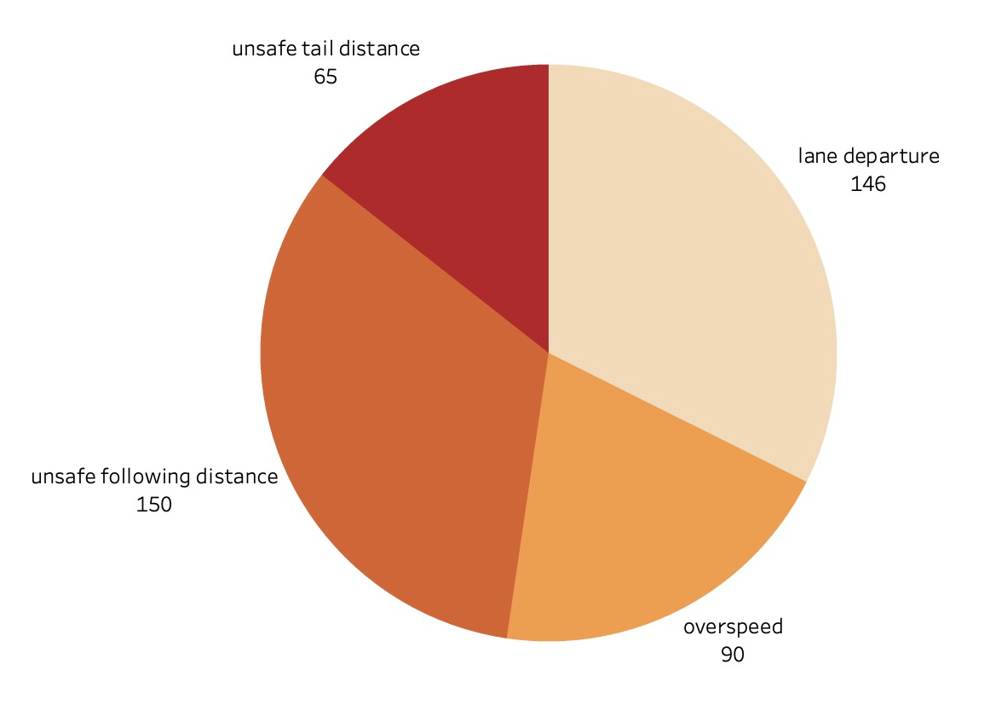
Accidents by Event Categories
The graph indicates that the highest number of violations occur as a result of "Unsafe Follow Distance," specifically 150 violations.
Additionally, violations resulting from "Lane Departure" are also notably high, at 146.
The remaining violations are attributed to "Unsafe Tail Distance" and "Overspeed."
Recommendations
Vehicle Maintenance: Ensuring that all vehicles are maintained regularly to avoid any mechanical issues that could cause lane departure or sudden stops leading to unsafe follow distances.
Real-time Monitoring: Installing real-time monitoring devices that alert drivers when they violate safe driving practices such as following distance, lane departure, and overspeeding.

Slide 16
recommendatioNs & Conclusion
The risk factor was determined not only by the driver, but also by external factors such as truck model, geographic location, and total miles driven
It is observed that most of the violations occurred in the northwestern part of California.
A comprehensive approach that includes a combination of driver training, proactive maintenance, and real-time monitoring of driver behavior and equipment performance can help reduce risk factors and improve safety on the road.
To further improve safety and reduce risk factors, it may also be helpful to implement a proactive maintenance program for all equipment, including regular inspections and repairs to identify and address potential issues before they become major problems. Additionally, implementing telematics systems that track driver behavior and equipment performance in real-time can help identify high-risk behaviors and address them before they result in incidents.

Slide 17
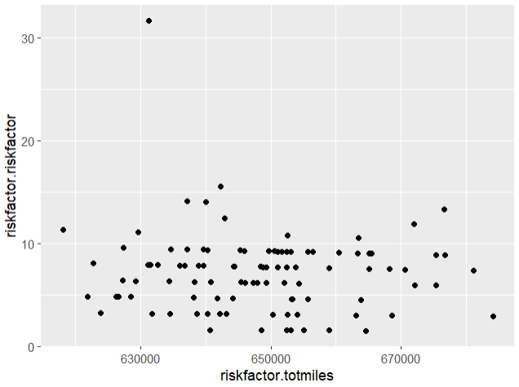
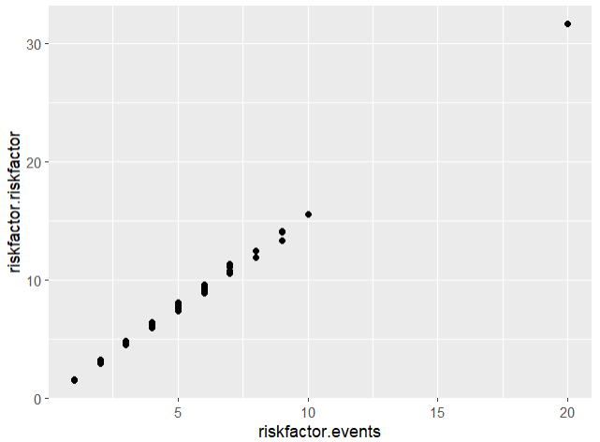
Scatter Plot in R to determine relation BETWEEN VARIABLES
In this exercise, we wanted to check if there is a correlation between risk factor and total miles
As we can see, there wasn't any correlation
There is a high correlation between events and risk factor which is intuitive since risk factor is derived from events

Slide 18
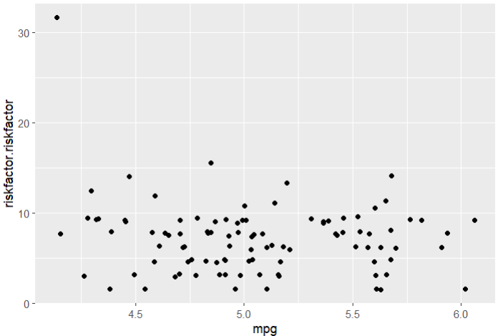
Scatter PlotS in R to determine relation BETWEEN VARIABLES
In this exercise, we wanted to check if there is a correlation between risk factor and total miles per gallon
As we can see, there is no significant correlation

Slide 19
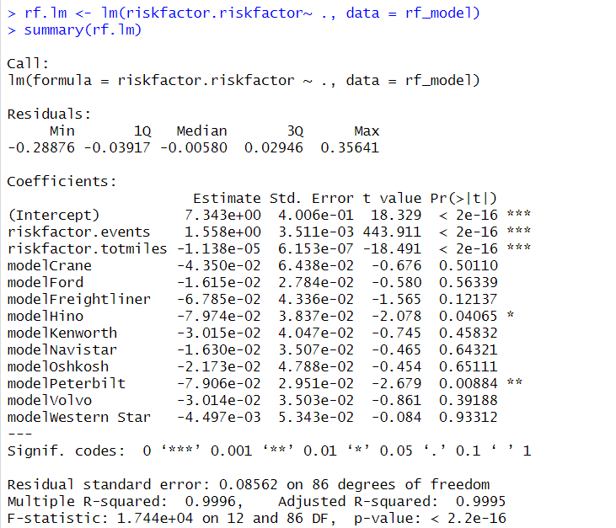
Food for thought – Does carrying out regression analysis hold value?
The team carried out regression analysis in an attempt to estimate the risk factor by using factors like events, model and number of miles driven
From the R2 squared values, we can see that the model is nearly perfect fit.

